Slide 1

DataBase project
Submitted by:
Tal Mizrahi
Gal Said
Katya Trofimenko

Slide 2
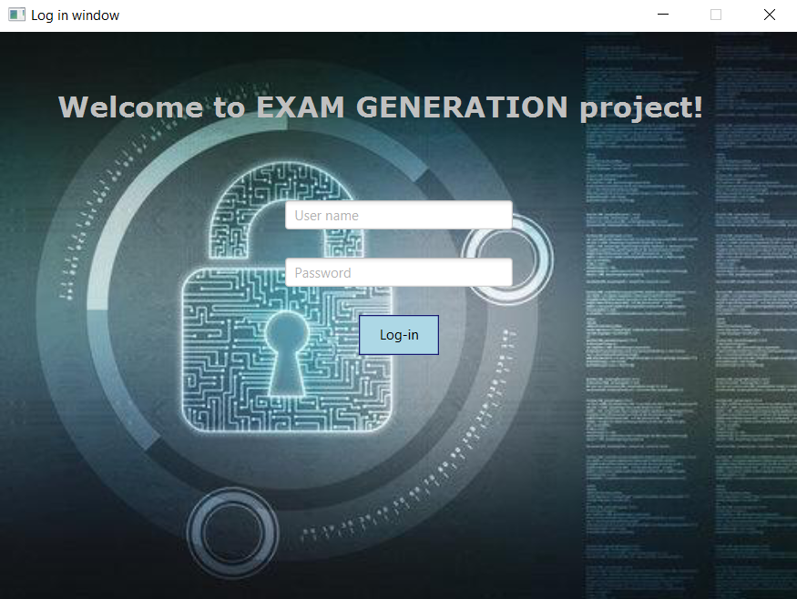
This project is about creating tests system.
You must first enter a username and password to get an access for the SQL system.

Slide 3
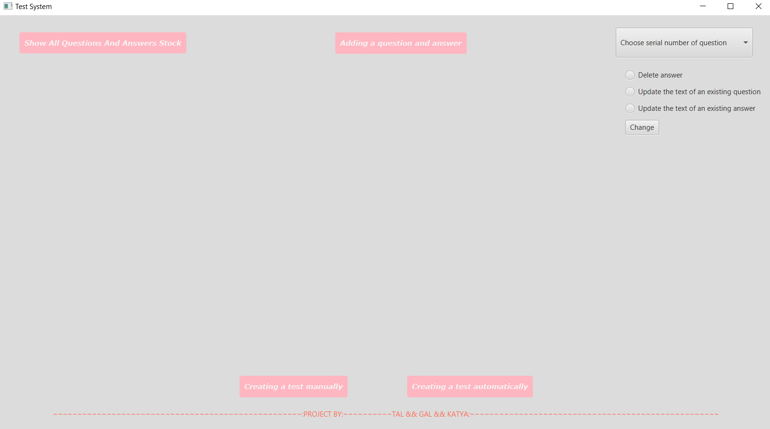
System functions
Displaying questions stock
Adding questions option: open or closed
Deleting an answer from a close question
Update answer text
Update question text
Creating a manual test
Creating an automatic test

Slide 4
Displaying questions stock
By clicking the "Show All Questions And Answers Stock“ button ,all questions and answers stock will be displayed.
To close the stock, press the "Close" button.
The user can view the questions stock at any stage
The database serves as a place for saving the entire stock of questions and answers so the user will be able to produce tests from them.
The database guarantees that there will be no duplicates in the existing stock.

Slide 5
Adding questions option: open or closed
By clicking the "Adding a question and answer" button, two options will appear:
"Adding open question“
"Adding close question“
The user should enter text for the question.
Going through the tables of the database, the program verifies that there is no identical wording of question from the same type.
If there are no duplicates, the user will enter an answer.
In case of close question , the user can enter 4-8 answers.
The program ensures that the answers for each close question are unique
Every answer and question have their own table in the database

Slide 6
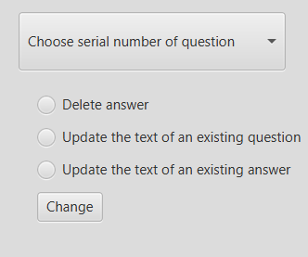
Delete and update
The user required to choose the serial number of the question.
For this functions we use the update and delete commands of the SQL.
The user can choose from one of the following options

Slide 7
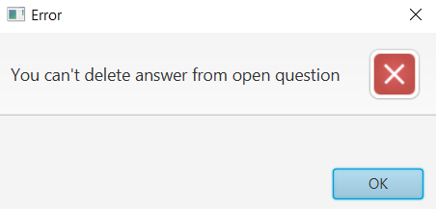
Deleting an answer from a close question
If the user choose serial number of an open question an error message appears.
The system requires at least 4 answers for a close question, the system uses the close question table from the SQL to enforce the limit.
In case that the answer is appears only in that specific question, the answer will also be deleted from the answer table.

Slide 8
Update answer text
For a close question, the user will choose which answer he would like to update.
An error message will appear in case that the user will try to insert existing answer wording.
The system performs this check by going over the table of close questions answers.
Here also , the answer will be deleted from the answer table, if it connect only to this question.

Slide 9
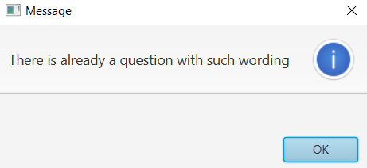
Update question wording
The user will enter new wording for the question he chose to update.
The system will check in the question table if the wording that was entered exists for that type of question.
If there is, an error message will pop up accordingly.

Slide 10
Creating a test
For each close question in test there are two default answers that are automatically added: "There is more than one answer“ "There is no correct answer“
The generated test will be saved in two different text files one for the solution and one for the questionnaire.
The database saves the information of the generated exams and provide us accessible way to the all data.
The user can create a test only from the questions that stored in the database

Slide 11
Manual test
The user’s first choice is the number of questions that he wants in the test.
Then he choose accordingly to the amount , the serial numbers of the question that he wants in the test.
If he chose a close question , he will be required to choose the answers he wants.

Slide 12
Automatic test
In this type of test , for each close question there is no more than one correct answer.
The user will choose how many questions he wants in a test, and the system will generate the test randomly according to the limits.

Slide 13




The users of the system
Academic institutions
Jobs interviewers
Selection test in the army
Driving theory test

Slide 14
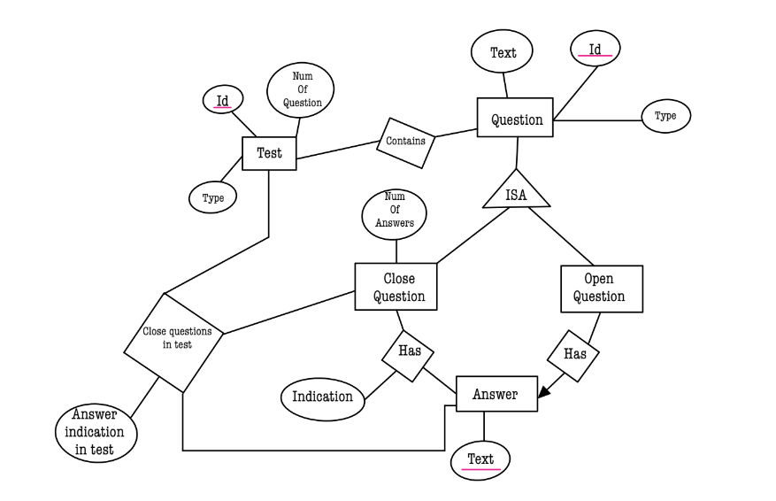
The ERD
Question – the base of all questions type
Open question –a type of question. Related to answer
Close question – a type of question, including a number of answers Related to answer table with indication
Answer – the answers stock
Test – generated from questions and their answer that are in the database

Slide 15

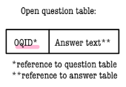

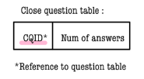
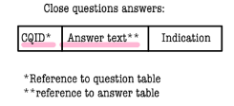
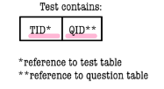

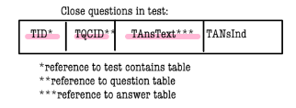
The tables
In tests, the indication of answers gets a different meaning from the origin

